Slide 1
Flying Squirrel
Jonathan Avila, Ryan Donnellan, Justin Joy, Owen Kehl, Joey Mathews

Slide 2
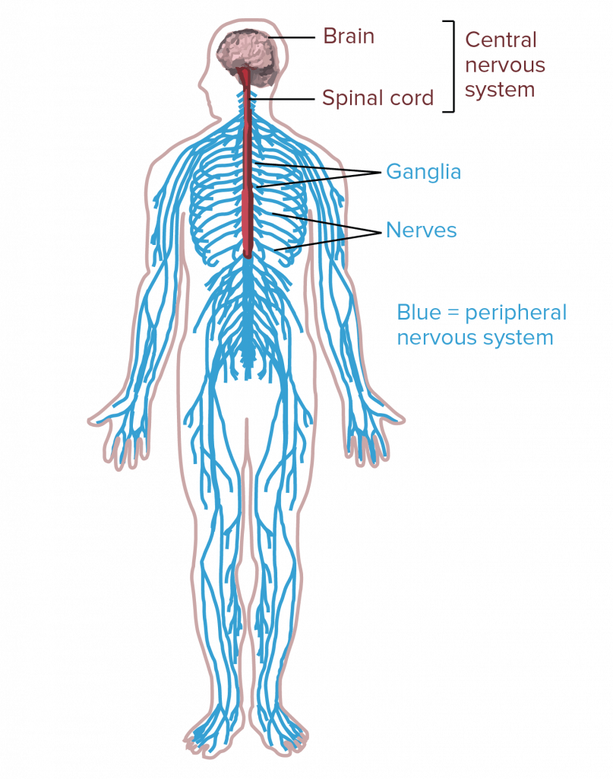
Background and Problem Statement
More than 795,000 strokes occur per year in the U.S., 610,000 of which are first or new [1]
Survivors suffer neurological damage, and often struggle with mobility
The Hamster assuages mobility issues by exercising arm movement in patients
Designed as a more affordable, at-home alternative to other complicated rehabilitation devices
The Flying Squirrel adds vertical motion while remaining within similar parameters
Sponsored by Dr. Razavian, who specializes in robotics and control algorithms
Figure 1: Human Nervous System

Slide 3
Black Box Model
Arm and Hand
Arm and Hand
Material
Strengthen motor function
Electrical, Human
Electrical, Human
Energy
On/Off, Turning Degrees, Buttons
Visual
Signal
Figure 2: Black Box
Notes:
how this influenced concept gen verbally

Slide 4
Functional Decomposition
Main Goal:
Strengthen Motor Function
Retain Hamster Functions
Add Vertical Motion
User Interface and
Therapy Exercises
Force and Position
Detection
Ensure Stability
Horizontal Movement
Add Lifting Capability
Wires and
Anchor Points
Preset Motion
Routines
Screws and
Threaded Pylons
Lifting Motors
Rollers
Pulling Motors
Encoder
Motors
Connecting Wires
Touch Screen
Or Buttons
Calibration Through
Anchor Points
3-Axis Load Sensor
Attachment
To Table
Chargeable Battery
Figure 3: Functional Decomposition
Notes:
Specify what colors mean/ how this influenced concept gen verbally

Slide 5
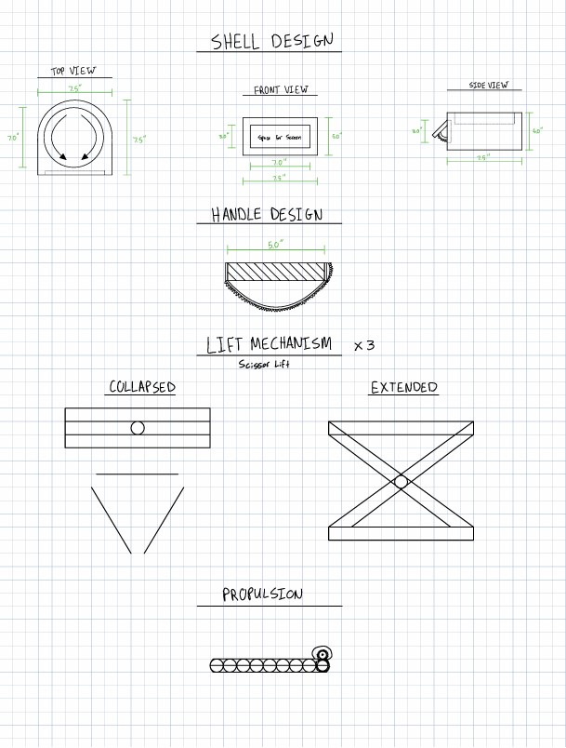
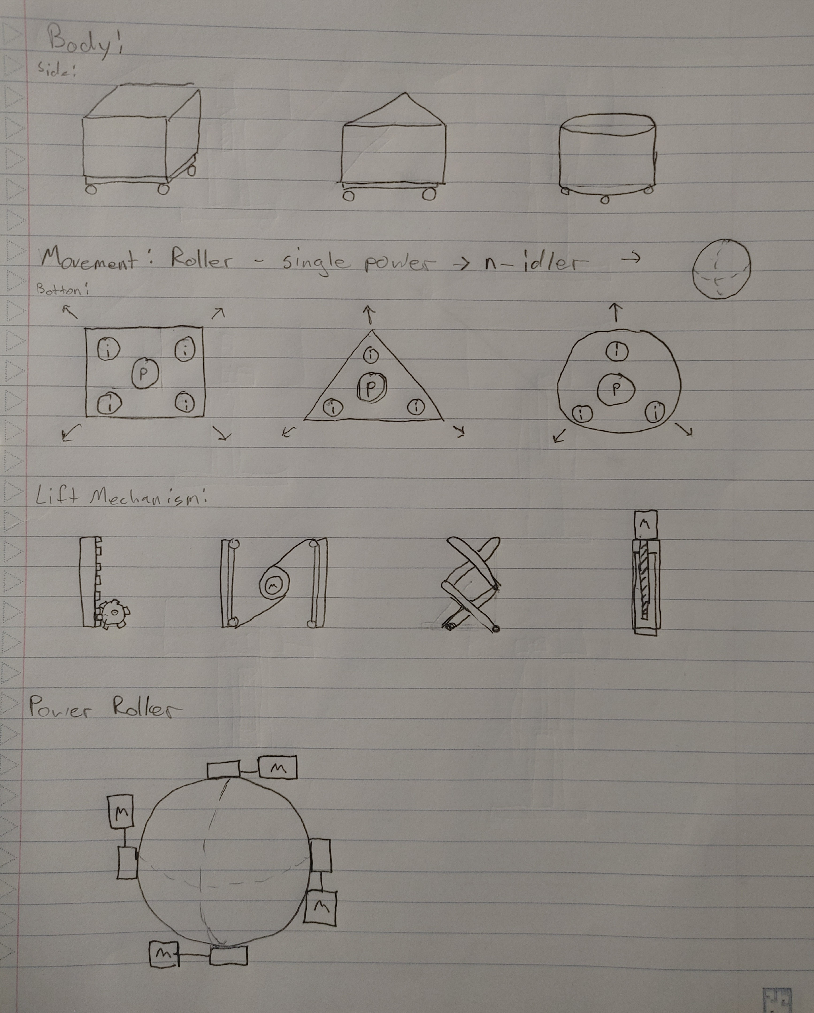
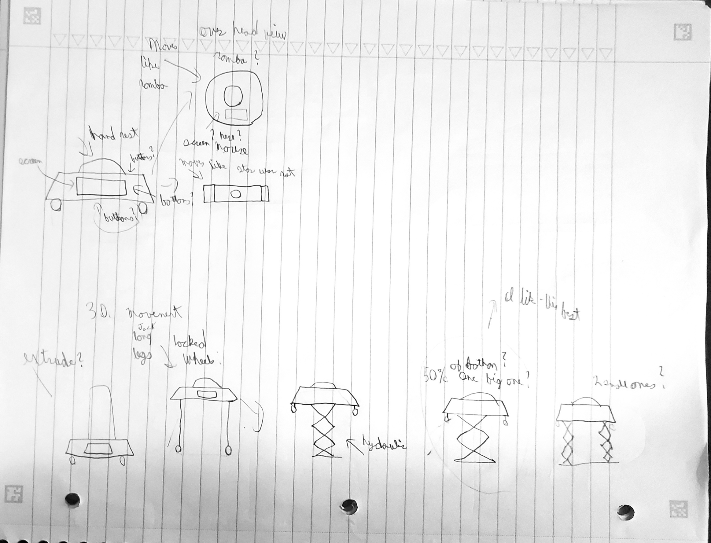
Concept Generation 1
During first client meeting, Dr. Razavian requested the team to complete the first concept generation.
John
Ryan
Justin
Figure 4-6: Concept Gen. 1
Notes:
Too many sketches and hard to see

Slide 6
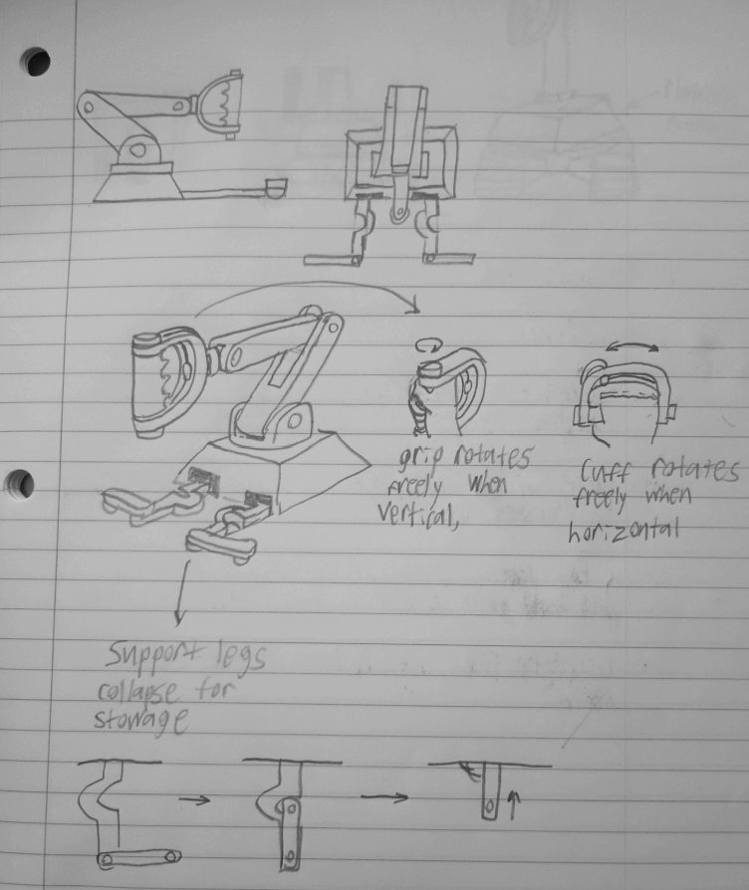
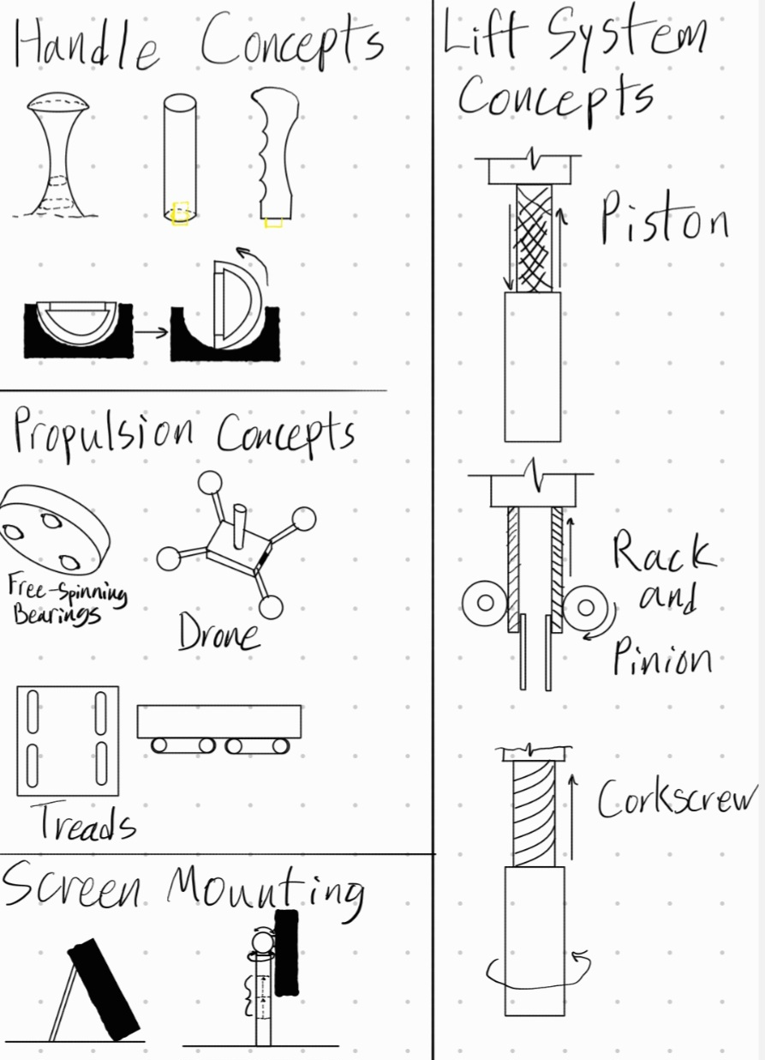
Concept Generation 1
Owen
Joey
Figure 7-8: Concept Gen. 1

Slide 7
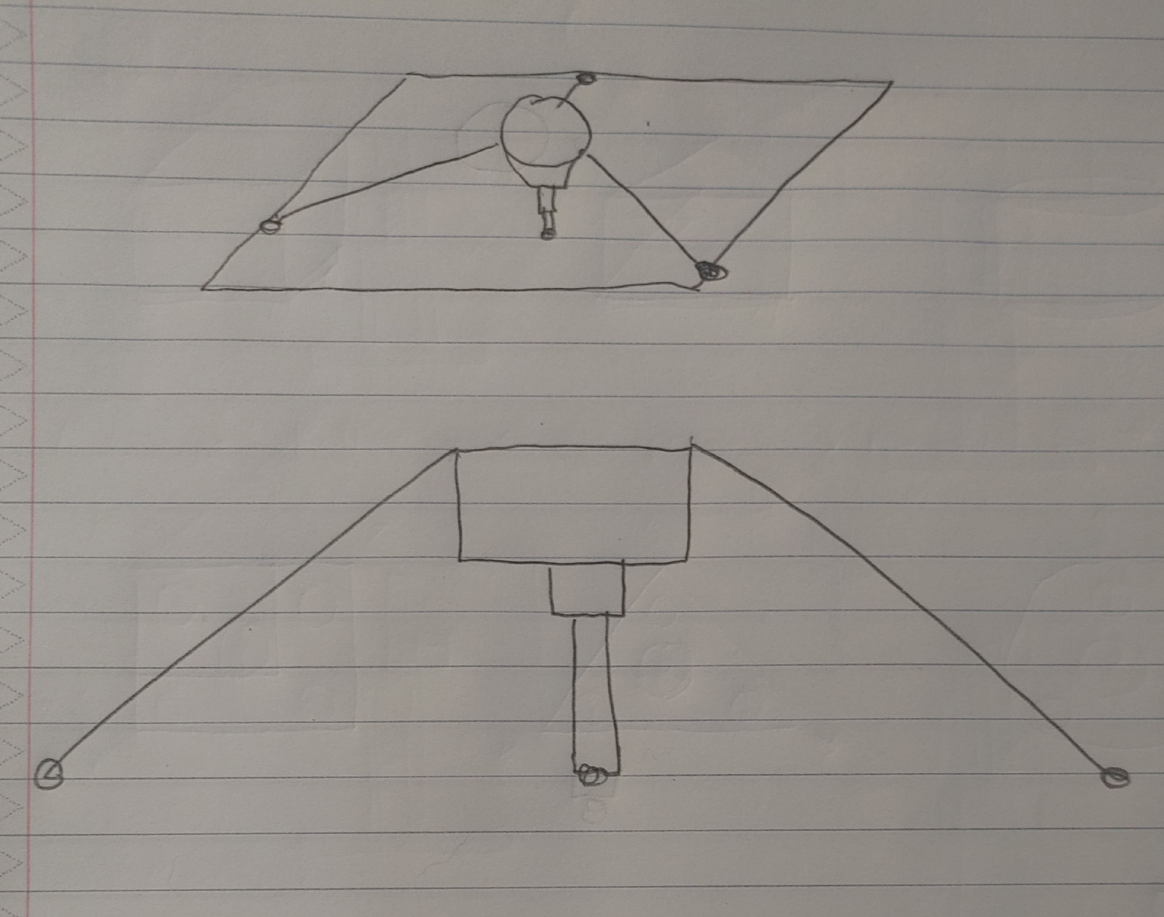
Client Concept Generation
Dr. Razavian
Presented cable driven robot to the team
Handle below body
Asked team for 2nd concept generation based on cable driven concept
Pros and Cons with 1st concept
Pros
Rollers
Direction speed changes
Lift
Screw
Rack/Pinion
Cons
Moment
Lack of control
Robotic Arm
Expensive
Tracks
Limited mobility
Figure 9: Client Concept

Slide 8
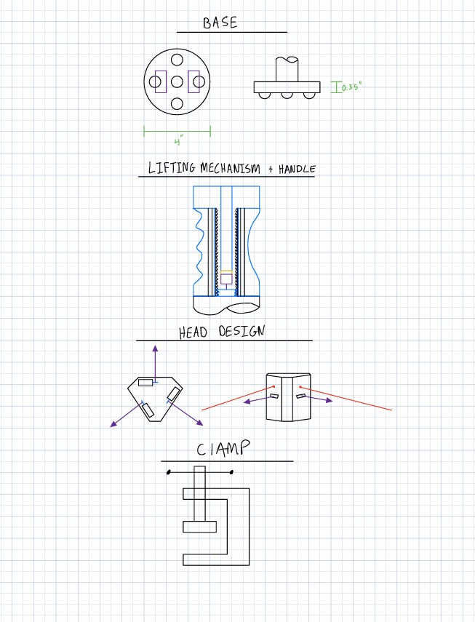
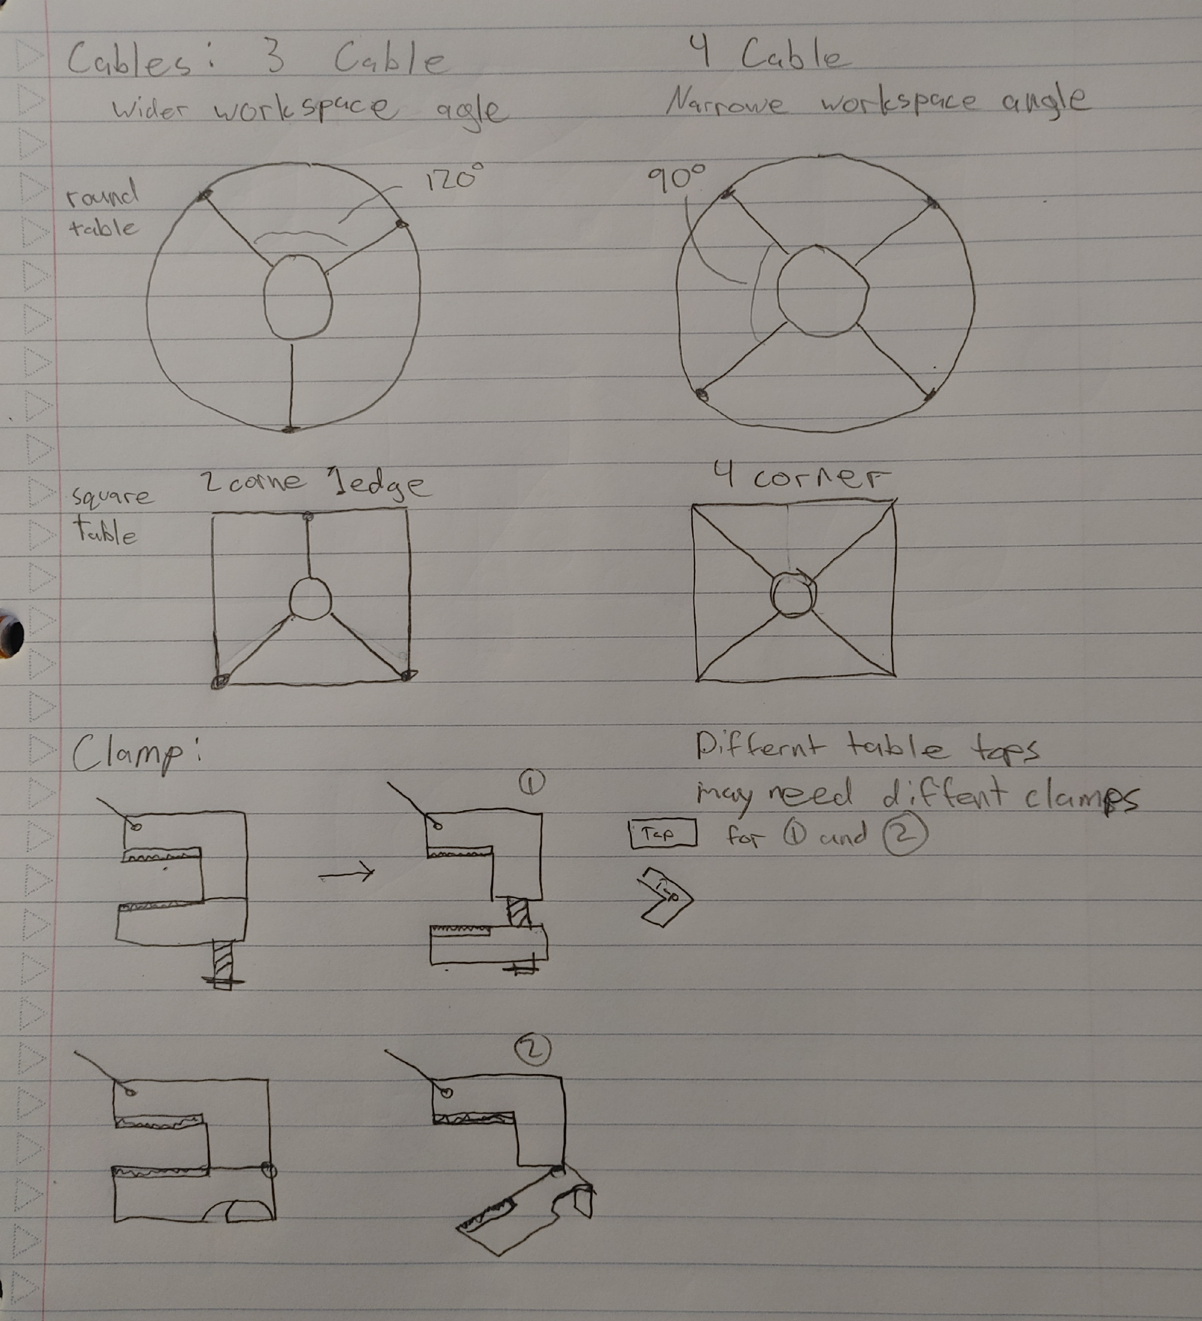
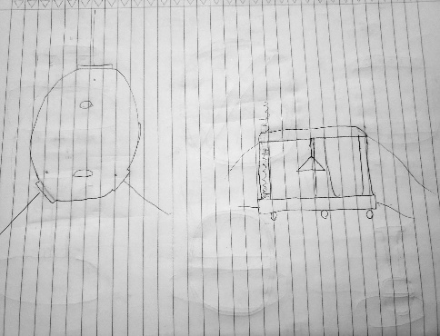
Concept Generation 2
During second client meeting, Dr. Razavian requested the team to complete a second concept generation based on the cable driven design.
John
Ryan
Justin
Figure 10-12: Concept Gen. 2

Slide 9
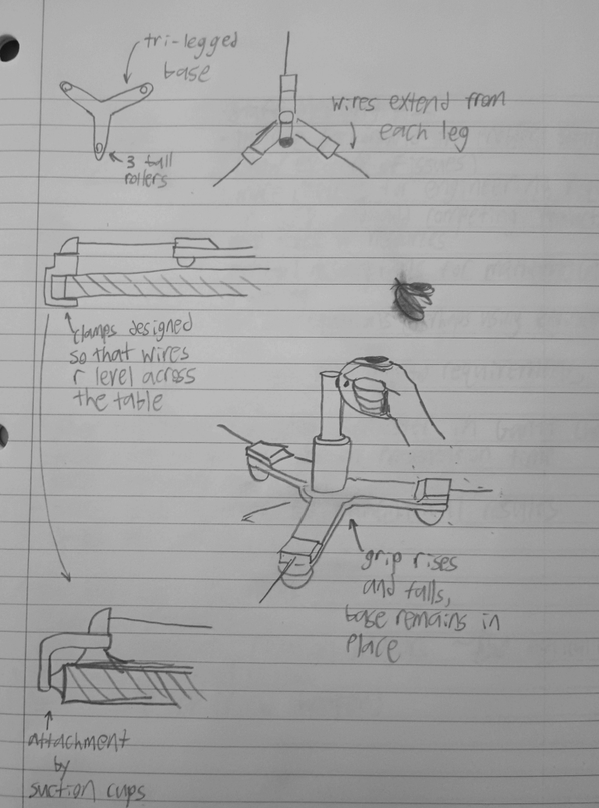
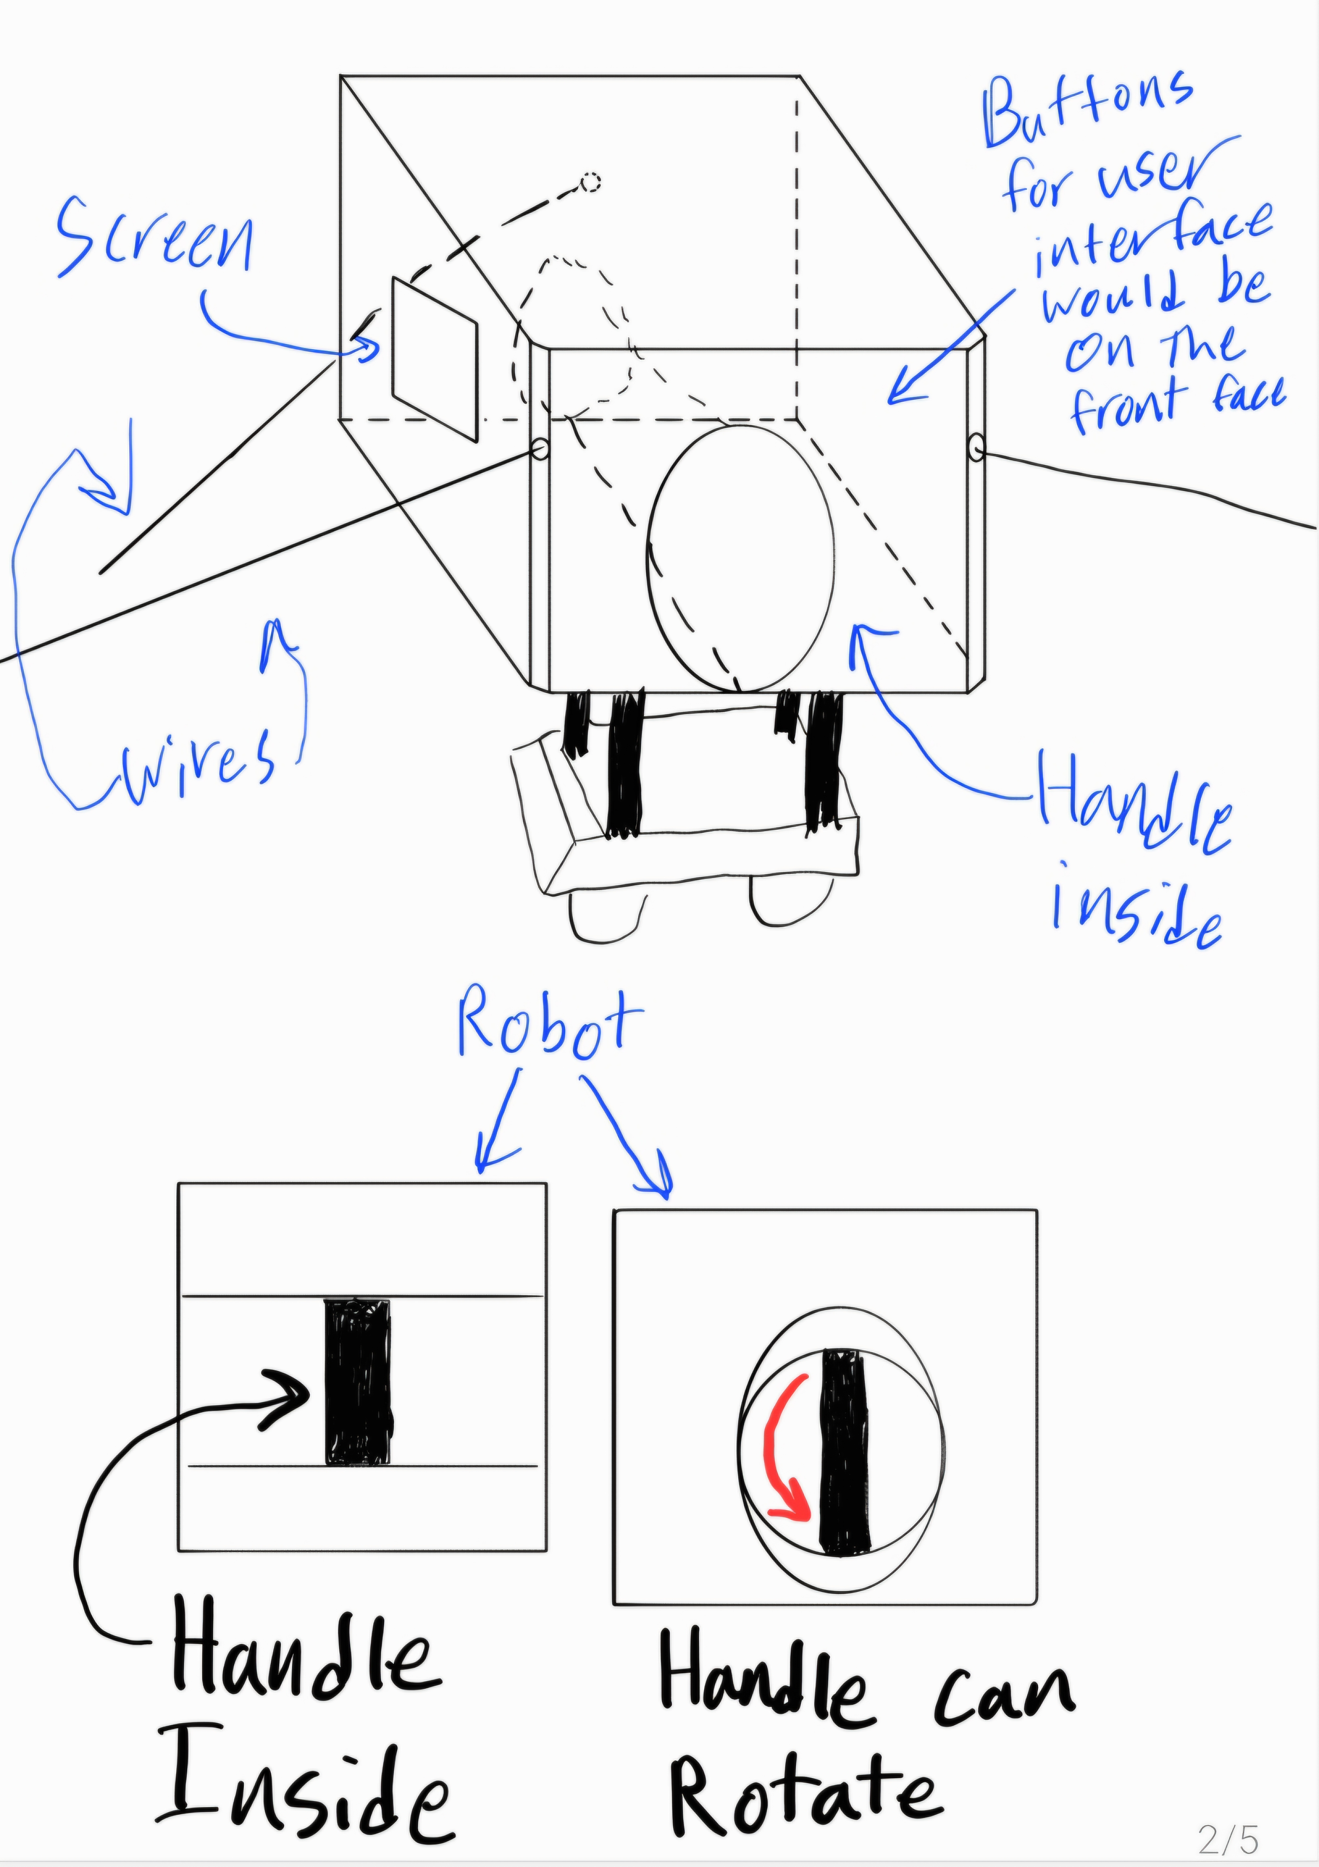
Concept Generation 2
Owen
Joey
Figure 13-14: Concept Gen. 2

Slide 10
Client Concept Generation
Dr. Razavian
Provided feedback on concepts for cable driven designs
Addressed obstacles
Cable clamp/cup
Design for 4 different table-tops
Small round
Small square
One-edge desk
Large shop table
Calibrations with cable angles
Requested CAD model
Cables need to be mounted on upper section of robot
Pros
Lift mechanism
Base can host hardware
Batteries
Control modules
Rollers
Lift motor
Cons
Need clamps for different table types
Lower cables do not prevent moment as efficient as higher cables

Slide 11
Engineering Calculations
Maximum Motor Torque Estimates
Validation
Guiding Assumptions:
(1) Cable tension is maximum required force (10 N = 2.24809 lbf)
(2) Only accounting for one motor
(3) Robot is in Equilibrium
(4) Cable's winch is 1 inch in diameter
τ = F*r
τ = 0.127Nm = 0.0937 lbf-ft
Adjusted Torque with a Factor of Safety of 2 (Suggested by Dr. Razavian):
τ_{adjusted} = F.O.S. * τ
τ_{adjusted} = 0.254 Nm = 0.1874 lbf-ft
We are writing a script in MATLAB to calculate the torque applied to all three motors simultaneously at every position within the robot's area of play. This will be used to find the maximum torque for each motor. The maximum torque is predicted to be close to our torque estimation.

Slide 12
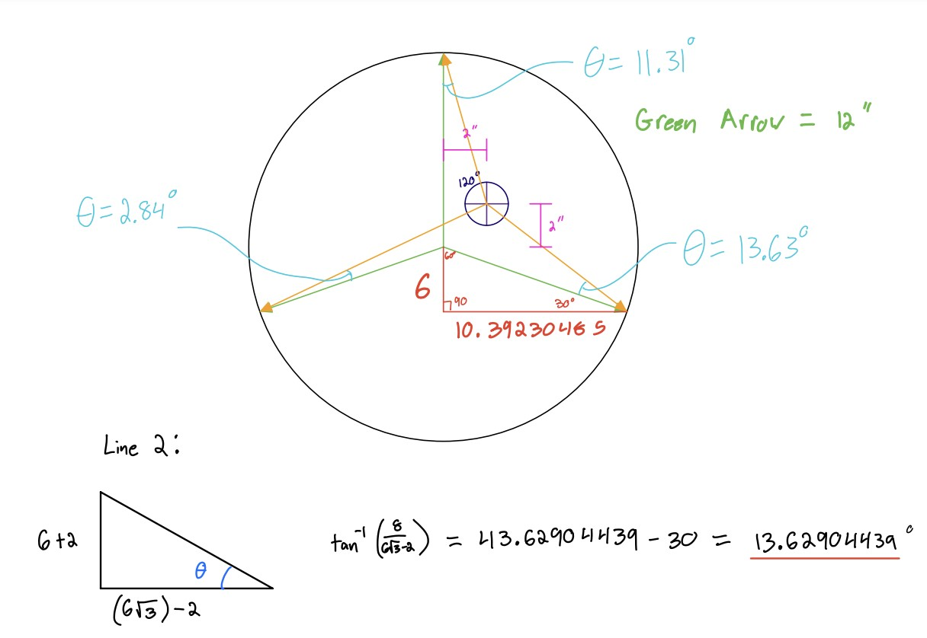
Engineering Calculations
Angle to Anchor Point
Validation
Guiding Assumptions:
(1) Static anchor points,
(2) equal length wires
Equation
θ = arctan(y / x)
Moving 2in right and 2in up, wire length = 12in
Line 1: 11.31° ccw
Line 2: 13.63° cw
Line 3: 2.84° ccw
Figure 15: Anchor point validation

Slide 13
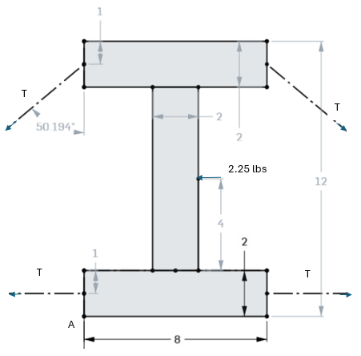
Engineering Calculations
Minimum Tension in Cables
Validation
Assuming cable is clamped 12 inches away from device.
Equation ∑MA=0 can be used for 2 cases
Cables attach at top and bottom
∑MA=0: TxL+FxL=0
T=2.2lbs
Cables only attached to top
∑MA=0: TxL+FxL=0
T=2.2lbs
Figure 16: FBD validation

Slide 14
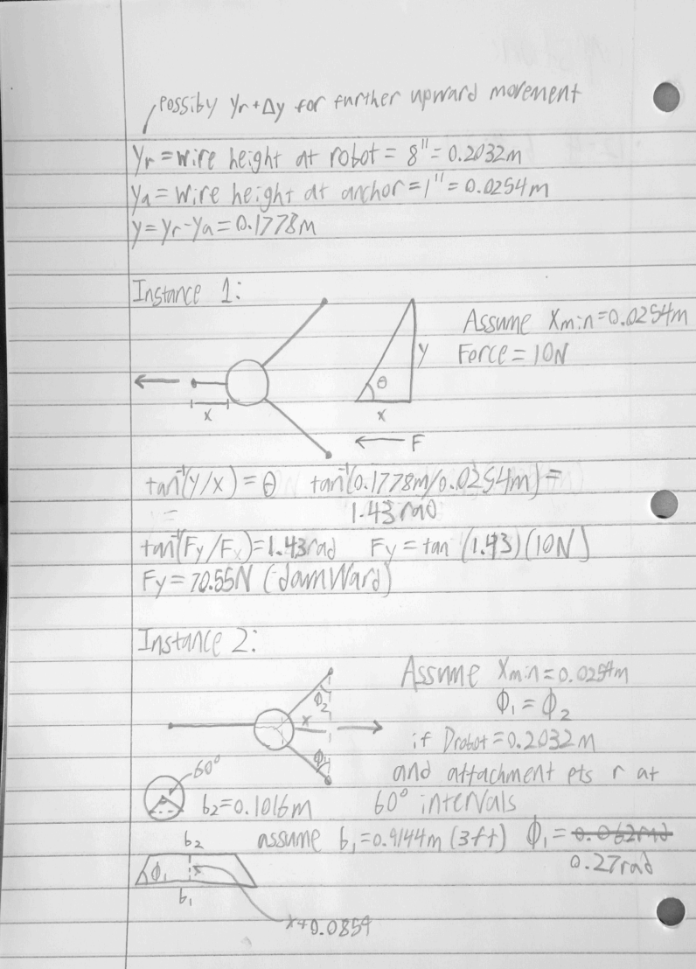
Engineering Calculations
Validation
Downward Force From Wires
y= height difference between robot attachment pt and anchor attachment pt
x= distance from robot to anchor or connecting line between anchors
D= diameter of robot (assume 8”)
Necessary horizontal force equals 10N
Assume y= 7” and x= 1” minimum
Instance 1:
Fy= 70.55N downward
Instance 2:
Assume 3’ between anchor pts
Fy= 14.55N downward
Figure 17: Downward force validation

Slide 15
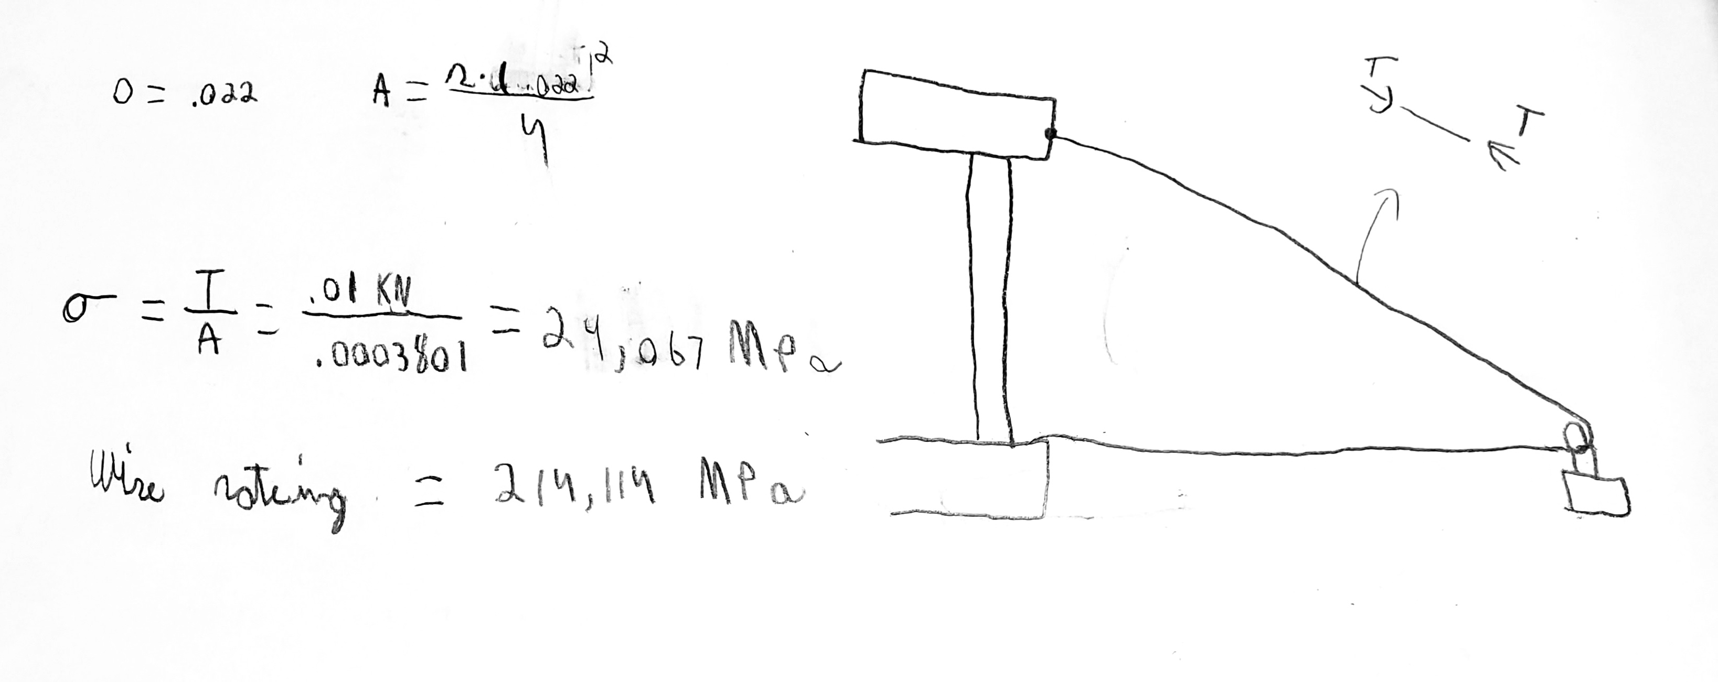
Engineering Calculations
Wire Max Stress
Validation
Explanation
To find the robot at its max stress, we will test it at what a worst-case scenario could be.
That would be ten newtons acting on a single wire.
T=10N
Equation
Stress=F/A=T/A
Stress=26,308 MPa
Wire rated strength is 214,114MPa
Figure 18: Stress force validation
Notes:
Add what the assumptions are and how we are going to utilize and validate, validate, validate. Accuracy of the numbers.

Slide 16
Calculations Table
Calculations Table
Equation | How it's applicable. | What requirements these equations meet. | How we validated the answers obtained.
t = I * Ah | Calculating minimum battery required to achieve desired run time. | Minimum run time of 30 minutes. | Obtained average power draw from online sources and used those to calculate time
θ = arctan(y / x) | Calculating position of robot as it moves closer to boundary | Position accuracy of 0.1mm | Solved equations by hand and used scale model to test angles
S=(F*nf) / A = (T*nf)/ A | Calculates the minimum amount of stress our cable needs to able to withstand | To be able to withstand 10 N of Force | By finding the amount stress induced we can select an appropriate wire
∑MA=0 | Calculates the minimum amount of tension in cables | Minimum tension needs to be 2.2lbs or nearly 10 N | Using structural analysis, the equation can be solved by hand
τ = F*r | Calculates the estimated maximum applied torque | Finding a motor that can output the required 10 N of force | Using a MATLAB script to calculate the torques at all positions the robot could be at
τadjusted = F.O.S. * τ | Calculates the estimated maximum applied torque using the factor of safety | Finding a motor that can output the required 10 N of force accounting for a factor of safety | Using a MATLAB script to calculate the torques at all positions the robot could be at
M= MP_{hm}g(L(1-0.5P_{hl}))+ MP_{fm}g(L(0.5P_{fl}+P_{al}))+ MP_{am}g(L(0.5P_{al})) | Calculates net upward force needed to move an extended arm | Moving user's hand with an upward force of 10 newtons | Used human body mass percentages and solved by hand
F_{y}= F_{t}*cos(θ) | Calculates downward force due to wire tension | Applying 10N force in horizontal and vertical directions | Solved by hand using force diagrams and position assumptions
Table 1: Calculations Table

Slide 17
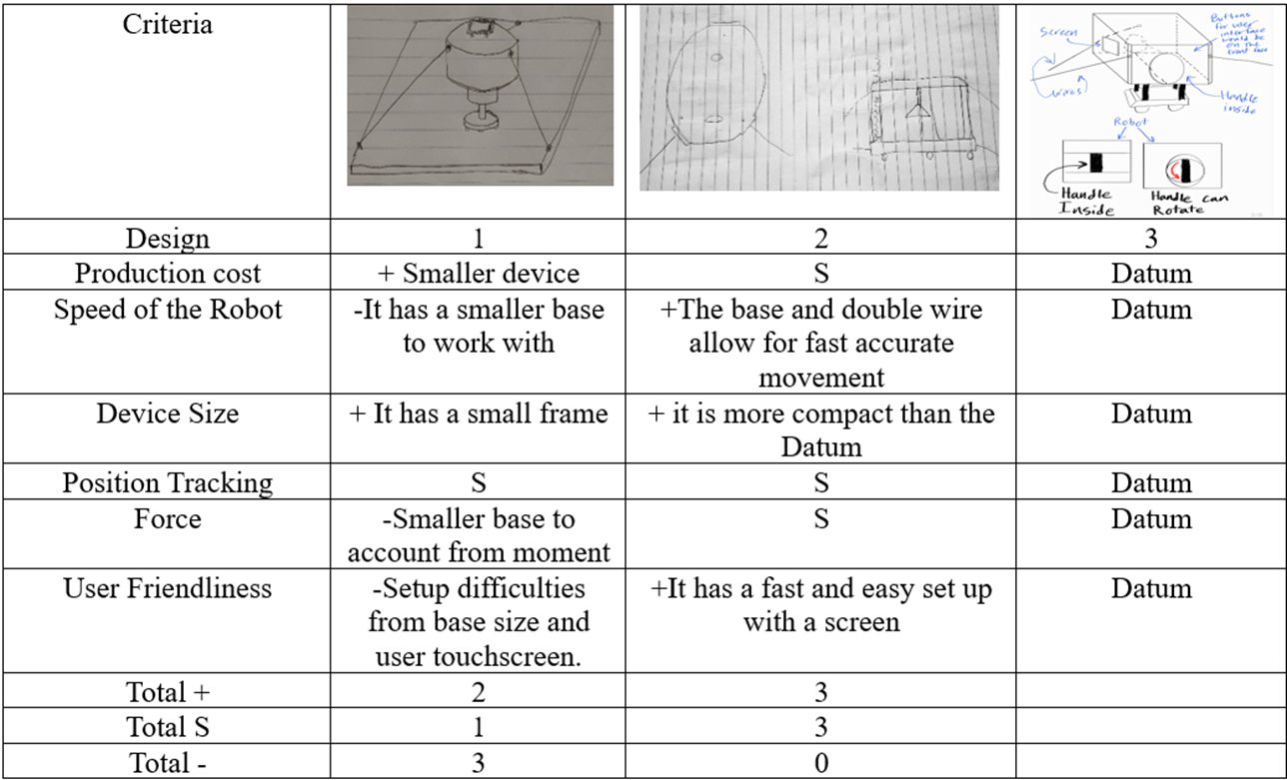
Pugh Chart
Design 2 is our best design according to the Pugh Chart
Table 2: Pugh Chart
Notes:
Explain why no decision matrix

Slide 18
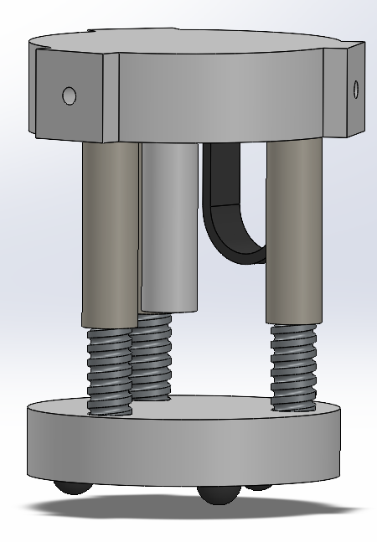
Concept Generation 3
John
Joey
Hybrid C Clamp and Suction anchor point
CAD Rough Draft
Height (When fully lowered) = 8 inches
D = 7 inches
Figure 19-20: Clamp and CAD Model
Notes:
Add major dimensions and components to CAD model, add how this compares to benchmarks and in someway demonstrate how we meet customer requirement. "This is what Reza wanted" also what requirements it meet.

Slide 19
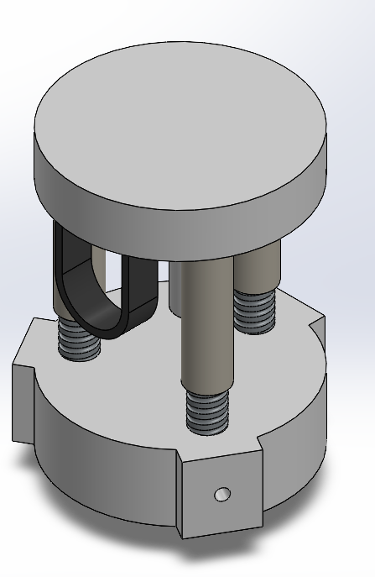
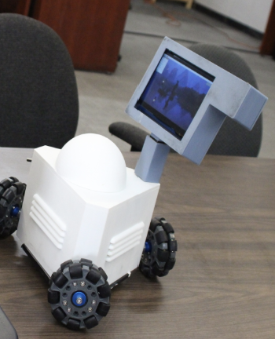
Benchmarking
Comparison to Other Products
Compact in stowed configuration
More affordable than other available models
Easily moveable for setup
Conceivably fast setup process
Comparatively simple motion design
Provides partial arm support
Provides vertical motion
PHOTO
Current CAD iteration compared to Hamster

Slide 20
Full Gantt Chart Goes Here

Slide 21
Notes:
Be very clear to inform Prof. Pete if we are on, ahead of or behind schedule.

Slide 22
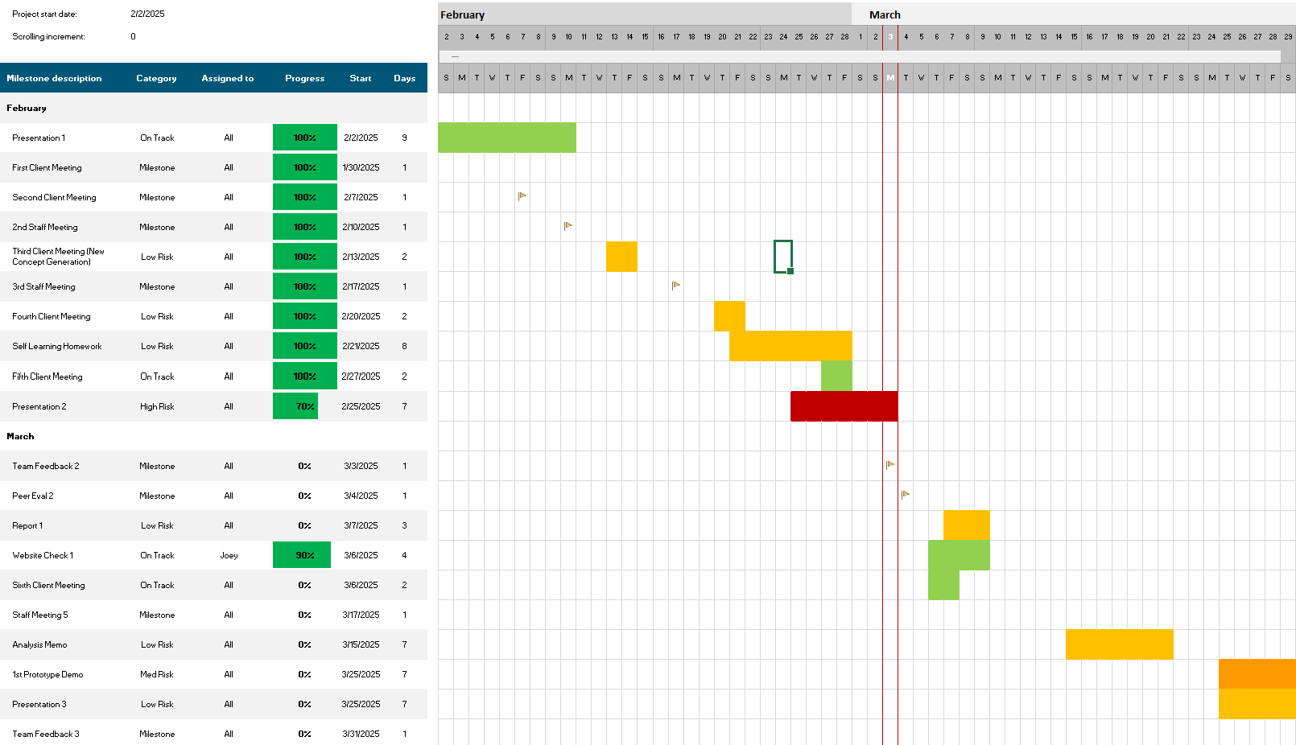
Gantt Chart and Schedule
Prepare 1st report
Continue client meetings
Flesh out CAD model
Perform further motion and force calculations

Slide 23
Budget
Fundraising
Current Project Budget | $3750
anticipated expenses | -$1350
Actual expenses to date | -$65
Resulting Balance | $2385
The Go fund me page is going to be open in the upcoming weeks.
On top of this we are working with ASME to do a fundraiser with a local restaurant for additional funds.
Table 2: Budget
Notes:
Specify fundraising.

Slide 24
Bill of Materials
 | Item | Quantity | Cost Per Unit ($) | Final Amounts($)
1 | 3-axis force sensor | 1 | 750 | 750
2 | Optical encoder motors | 4 | 50 | 200
3 | 18650 Battery | 3 | 25 (sold in 4 pack) | 25
4 | Braided Fishing Line | 1 | 30 | 30
5 | Circuits and wires | 1 Sold as a set | 45 | 45
6 | Misc. Electronics and plastics | 1 | 100 | 100
7 | Stainless Steel Ball Bearings | 1 sold in large set amounts | 6 | 6
8 | Suction Mechanism | 3 | 15 | 45
9 | C clamps | 3 | 5 | 15
 |  |  | Final Subtotal= | 1216
Notes to Consider
Dr. Razavian asked that we include a force sensor and because of the price has informed us the production budget limit is no longer $1000
Table 3: Bill of Materials
Notes:
Highlight major components on CAD

Slide 25
Thank you!

Slide 26
Question?

Slide 27
Resources
[1] “Stroke Facts.” CDC. https://www.cdc.gov/stroke/data-research/facts-stats/index.html (accessed February 23, 2025).

